Slide 1
Audio classification
Tashik Moin K180142 Sajjad Ali K180355

Slide 2
Roles
Tashik Data pre-processing, MFCC, Files mapping, Code.
Sajjad Design, MFCC, Dataset, Analysis, Code

Slide 3
Background And Motivation
Audio classification is the process of listening to and analyzing audio recordings. Also known as sound classification, this process is at the heart of a variety of modern AI technology including virtual assistants, automatic speech recognition, and text to speech applications. Sound/Audio Classification is one the most widely used applications in Audio Deep Learning. It involves learning to classify sounds and to predict the category of that sound. Audio Classification is an interesting problem in Machine Learning and Deep Learning, which mainly target for recognizing and relating sounds from audio. This type of problem can be applied to many scenarios for example classifying music clips to identify the genre of the music, or classifying short utterances by a set of speakers to identify the speaker based on the voice.
Observing the recent advancements in the field of image classification where convolutional neural networks are used to classify images with high accuracy and at scale, it begs the question of the applicability of these techniques in other domains, such as sound classification.
Motivated by Google research which recently released a sound vocabulary and dataset aiming to provide a common, realistic-scale evaluation platform for audio event classification such as human sounds, music genres, environmental sounds (see https://research.google.com/audioset/ ).

Slide 4
Design
The algorithm uses audio libraries of python like librosa with a simple ANN model to train the model with features of Mel-frequency cepstral coefficients (MFCC). Mel-frequency Cepstral coefficients is proposed and the feature set is analyzed for its pertinence in the proposed task. A simple Artificial neural network is proposed which offers a classification accuracy of 95% to distinguish between 10 audio classes. According to some research papers the proposed architecture when compared with a Support Vector Machine based classifier, then it is found that it has performed extremely well. Reference: https://www.researchgate.net/publication/4310665_A_Neural_Network_based_Audio_Content_Classification https://ieeexplore.ieee.org/document/8285499

Slide 5
Methodology
Spectrogram A spectrogram is a visual representation of the spectrum of frequencies of a signal which allows us to see sounds, it varies with time. When applied to an audio signal, spectrograms are sometimes called sonographs, voiceprints, or voicegrams. When the data are represented in a 3D plot, they may be called waterfalls.
MFCC Mel scale is a scale that relates the perceived frequency of a tone to the actual measured frequency. It scales the frequency in order to match more closely what the human ear can hear (humans are better at identifying small changes in speech at lower frequencies because humans can perceive sound logarithmically). Using Mel scale, Mel spectrogram and the MFCC, we can make a deep learning model that can learn like a human. We use a Mel scale because it is a relevant scale for pitch. MFCC is used because it describes the “large” structures of spectrum, ignores fine spectral structures and works well in audio classification, speech and music recognition. The MFCC feature extraction technique basically includes windowing the signal, applying the DFT, taking the log of the magnitude, and then warping the frequencies on a Mel scale, followed by applying the inverse DCT. In practice, the first 8–13 MFCC coefficients are used to represent the shape of the spectrum. However, some applications require more higher-order coefficients to capture pitch and tone information. For example, in Chinese speech recognition up to 20 cepstral coefficients may be beneficial [130]. Variations of MFCCs.

Slide 6
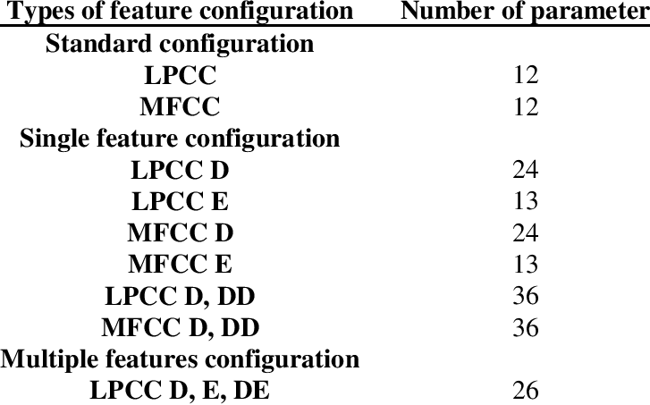

Slide 7
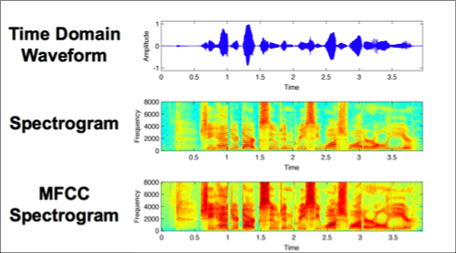
Methodology (Continued)
Ideal Audio Feature
1. Time-frequency representation. 2. Perceptually-relevant amplitude representation (This is non-linear and logarithmic and can be achieved using the vanilla spectrogram). 3. Perceptually-relevant frequency representation. (This representation can only be achieved using Mel spectrogram).
Discrete Fourier Transformation
The Discrete Fourier Transform (DFT) is of paramount importance in all areas of digital signal processing. It is used to derive a frequency-domain (spectral) representation of the signal.

Slide 8
Methodology (Continued)
Dataset
For this we have use a dataset called Urbansoun8K. The dataset contains 8732 sound excerpts (<= 4s) of sounds from 10 classes, which are as follow:
Air Conditioner
Car Horn
Children Playing
Dog Bark
Drilling
Engine Idling
Gun Shot
Jackhammer
Siren
Street Music

Slide 9
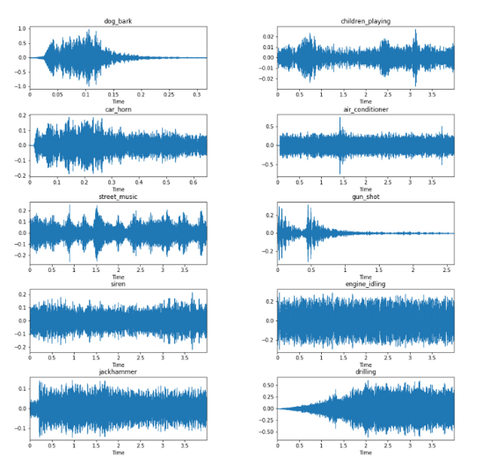
Methodology (Continued)

Slide 10
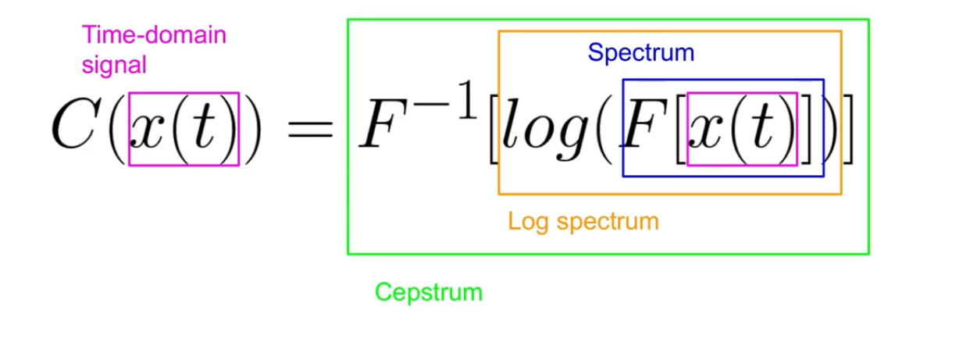
Methodology (Continued)

Slide 11
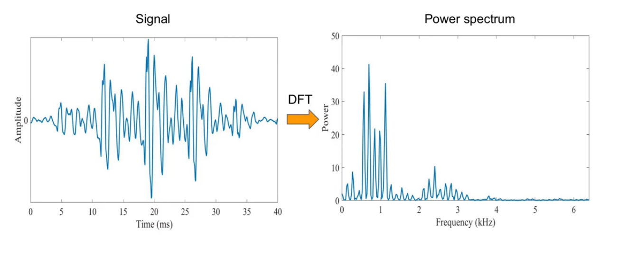
Methodology (Continued)

Slide 12
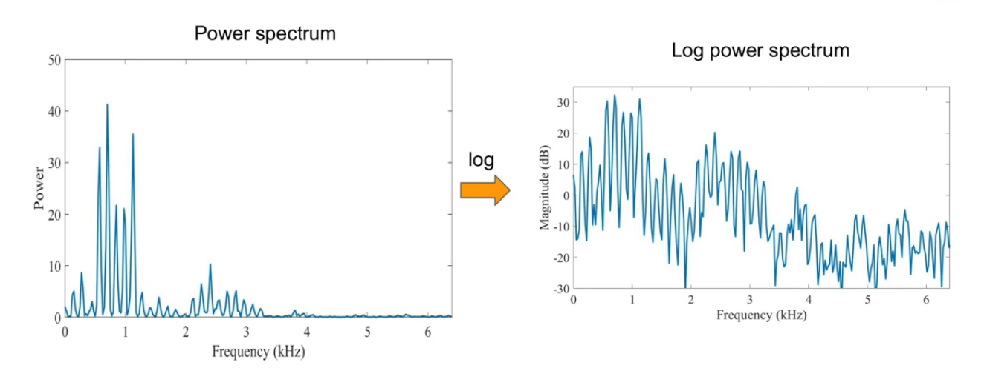
Methodology (Continued)

Slide 13
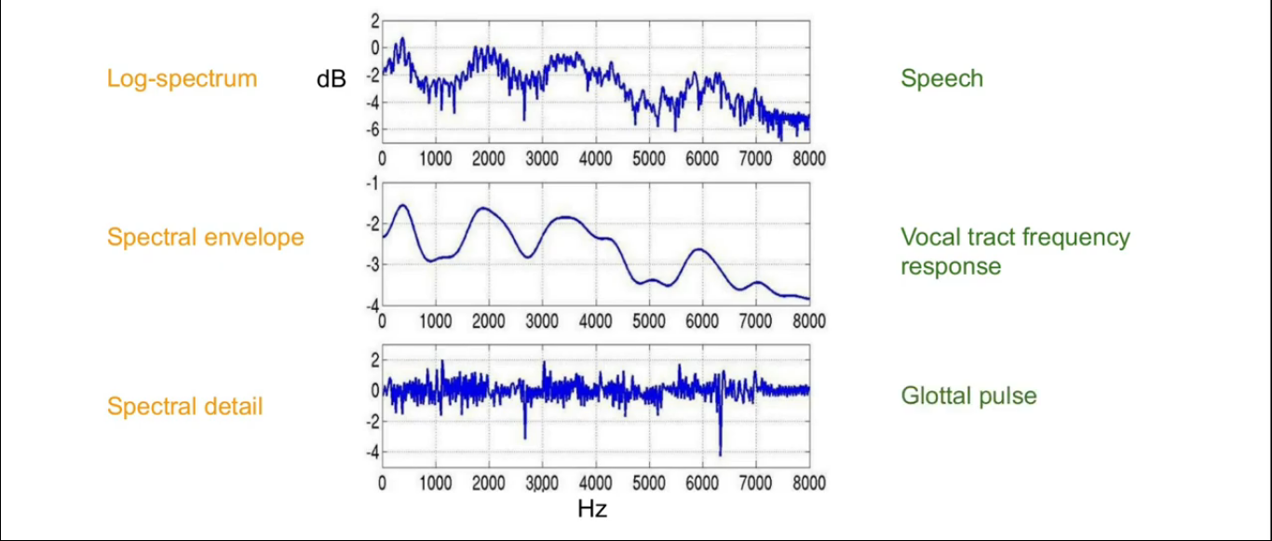
Methodology (Continued)

Slide 14
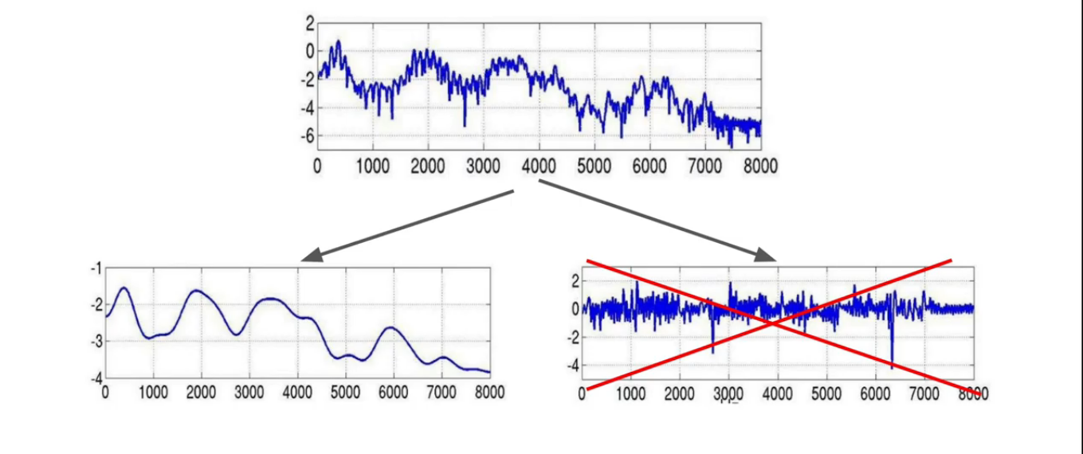
Methodology (Continued)
References: https://www.ncbi.nlm.nih.gov/pmc/articles/PMC5412481/

Slide 15
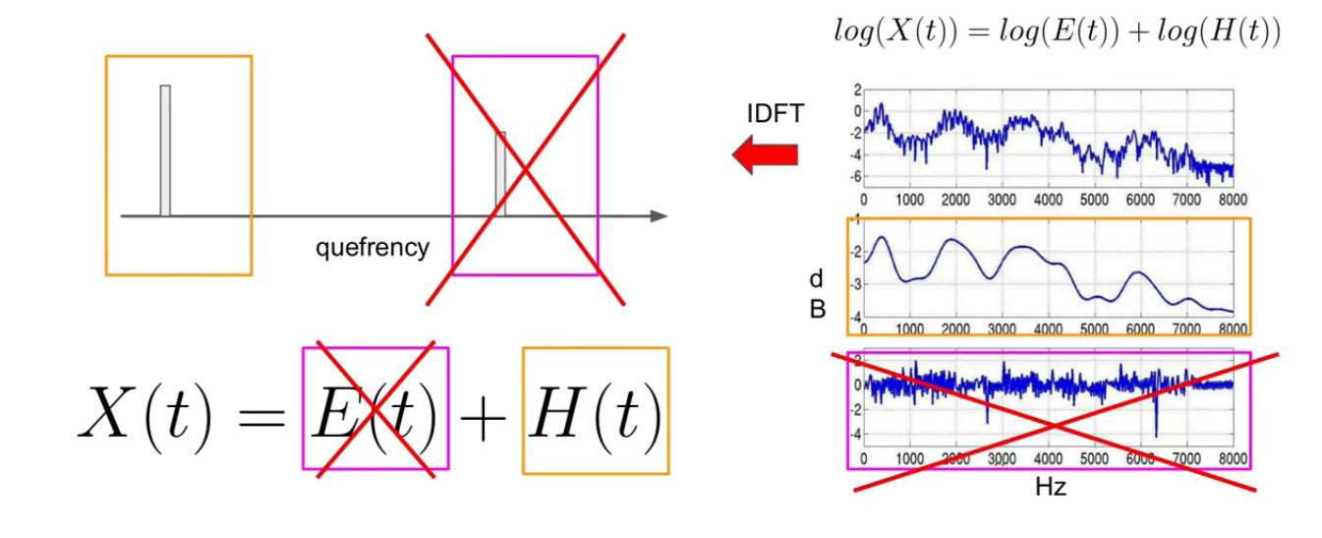
Methodology (Continued)

Slide 16
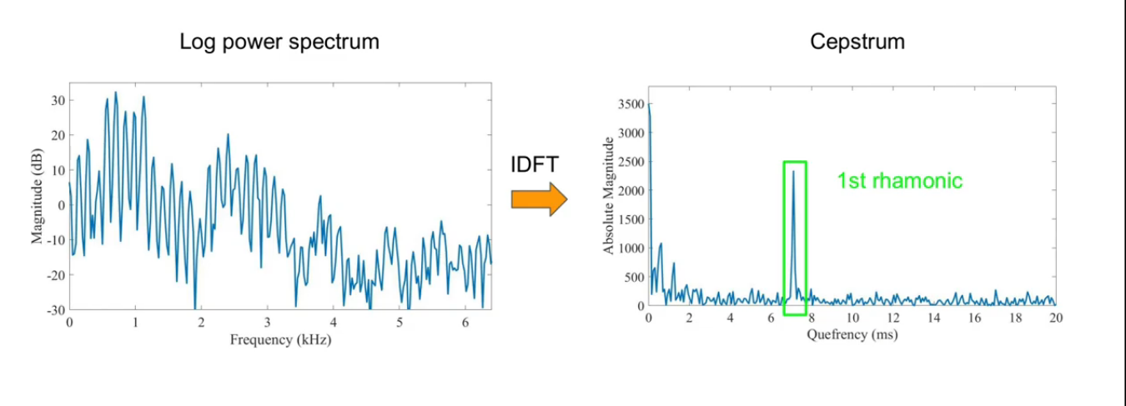
Methodology (Continued)

Slide 17
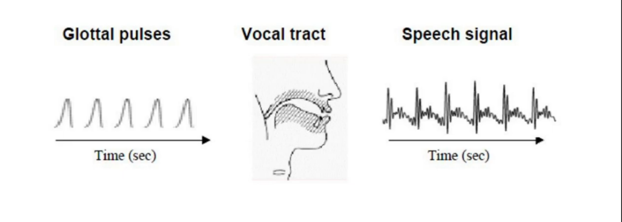
Methodology (Continued)

Slide 18
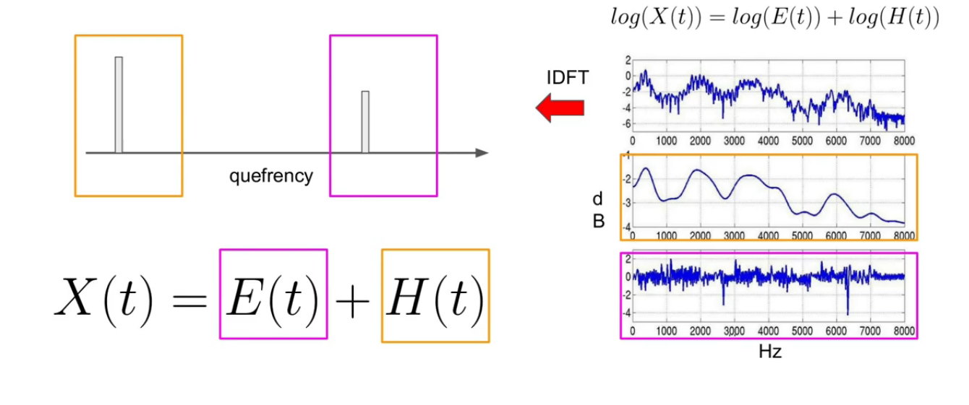
Methodology (Continued)

Slide 19
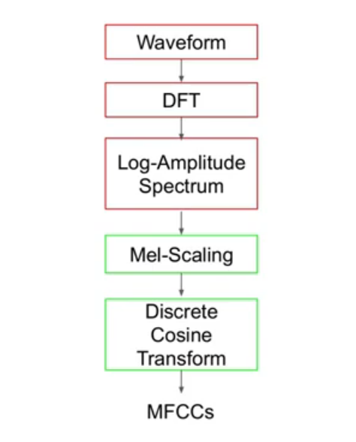
Methodology (Continued)

Slide 20
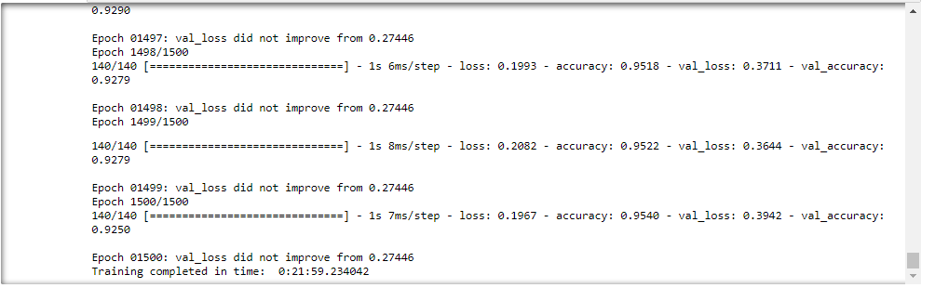
Results
Our trained model obtained a Training accuracy of 95.19% and a Testing accuracy of 92.50%.The performance is very good and the model has generalized well, seeming to predict well when tested against new audio data.

Slide 21
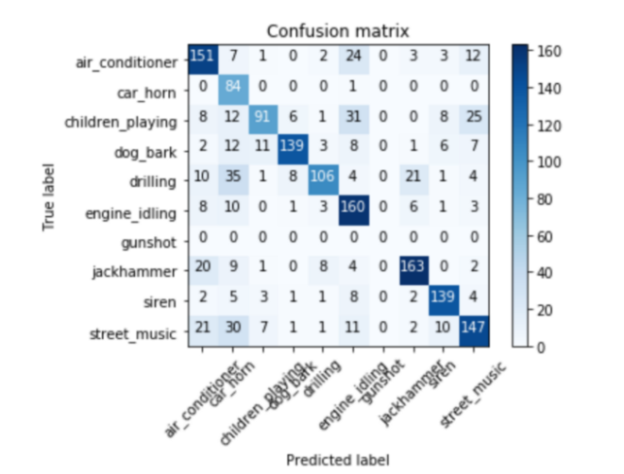

Slide 22
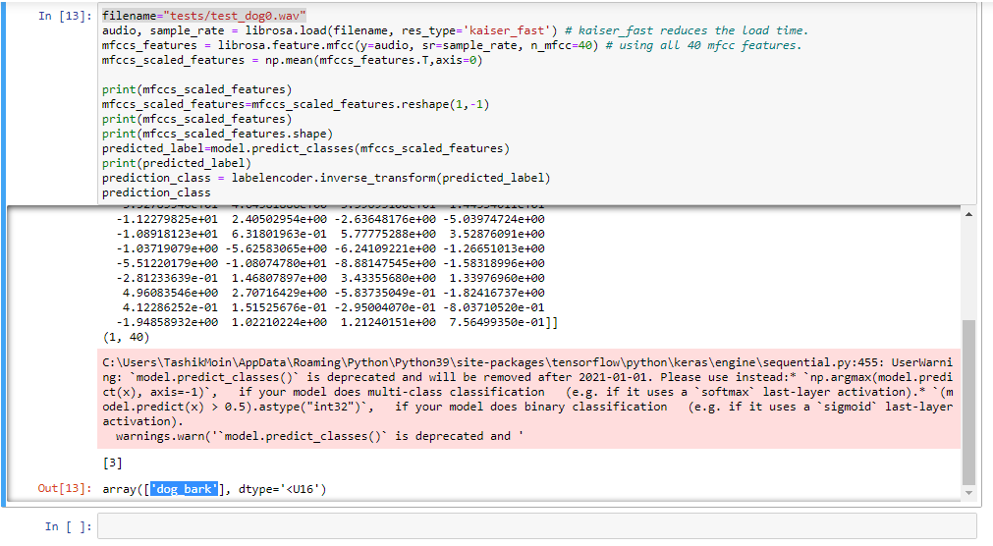
Results (Continued)

Slide 23
Conclusion And Future Work
We have now seen an end-to-end example of sound classification which is one of the most foundational problems in audio deep learning. Not only is this used in a wide range of applications, but many of the concepts and techniques that we covered here will be relevant to more complicated audio problems.
Future Work Speech Classifying short utterances by a set of speakers to identify the speaker based on the voice. Music Classifying music clips to identify the genre of the music. Environmental Sounds In addition to speech and music signals, other sounds also carry a wealth of relevant information about our environments.

